Slide 1
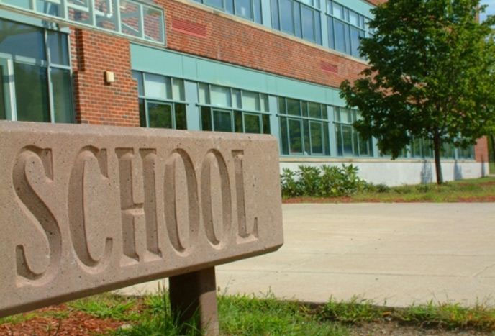

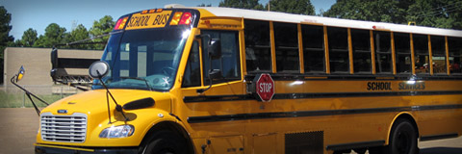
American high schools

Slide 2
Educate,
education,
kindergarten,
elementary school,
junior school,
high school,
grade,
mark,
start school,
leave school,
drive,
subject,
extra-curricular activity,
experience,
discussion,
class

Slide 3
Answer the questions
How many levels are there in American educational system?
What are they?
At what age do American children start school? What kind of school is it?
Where do American children go before school? At what age do they start kindergarten?
How many years do American children study at elementary school?
What is the second level of educational system in the USA?
How many years do American children study at junior school?
What is the last level of school system in the USA?
How many years do American children study at high school?

Slide 4

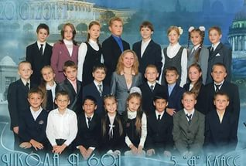
Grade or grader
1
2

Slide 5
Explain the words
freshman, sophomore, junior, senior
Ex: A freshman is a …….

Slide 6
Keys: 1-relaxing, 2-educational, 3-driving,
4-locker, 5-twice, 6- sporty, 7- organizing,
8- extremely
8 correct answers – your mark is 5;
6-7 correct answers – your mark is 4:
4-5 correct answers – your mark is 3:
less 3 correct answers – your mark is 2.

Slide 7
Keys: 1-T, 2-F, 3-F, 4-T, 5-F, 6-T, 7-F, 8-F.
8 correct answers – your mark is 5;
6-7 correct answers – your mark is 4:
4-5 correct answers – your mark is 3:
less 3 correct answers – your mark is 2.

